Slide 1
Time Complexity
Srivaths P

Slide 2
Goal:
Understand time complexity
Understand Big-O notation for time complexity.
Evaluate time complexity of an algorithm.
Evaluate expected time complexity based on the given constraints of a problem.
Evaluating space complexity of a program.
Common verdicts of submissions.

Slide 3
What is an Elementary Operation?
An operation that takes constant time is called elementary operation.
Example:
Arithmetic operations
Comparison of primitive types
Input and output of primitive types
10⁸ operations ≈ 1 second

Slide 4
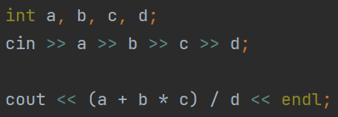
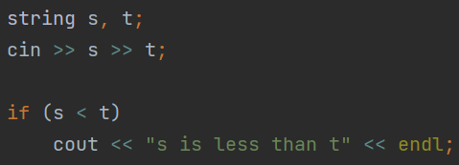
Quiz 1
Is the following an elementary operation?
Is the following an elementary operation?

Slide 5
What is Time Complexity?
Time complexity is a function to describe the approximate amount of operations an algorithm requires for the given input.
We can calculate approximate execution time of code using time complexity and constraints.

Slide 6
Big-O notation
Big-O of an algorithm is a function to calculate the worst case time complexity of the algorithm.
It is written as O(worst case time complexity)
Big-O is used to calculate the approximate upper bound of the algorithm. It expresses how the run time of the algorithm grows relative to the input.
More convenient and useful than other notations.

Slide 7
Rules for Big-O notation
Should not have constants.
Should not have constant factors.
Only include the fastest growing function for each variable.
Can never be 0. Has to be atleast O(1)
Example function: 2(N²) + 4N + 4(M³ + 5) + 10

Slide 8
Quiz 2
(N+M) / K
N(N+1)/2
N² + M(N²) + M²(N) + NM
N³/64 + 20N + (32NM)²

Slide 9
Calculate Time Complexity of an Algorithm
Time complexity usually depends on:
Loops
Recursion
Time complexity of recursive algorithms will not be covered.
Note: Usage of STL counts for time complexity

Slide 10
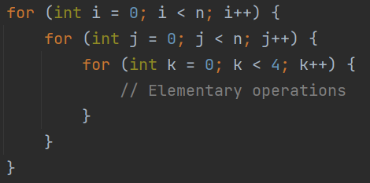
Calculate Time Complexity of an Algorithm
If there are nested loops, multiply the expected number of iterations of the loops
Example:

Slide 11
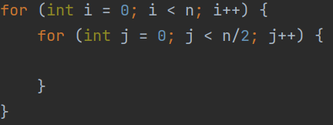
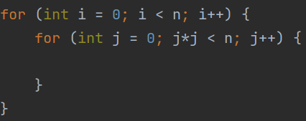
Quiz 3
Find the time complexity of the following code snippets in Big-O notation:

Slide 12

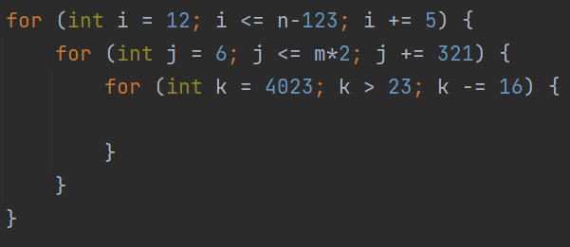
Quiz 3

Slide 13
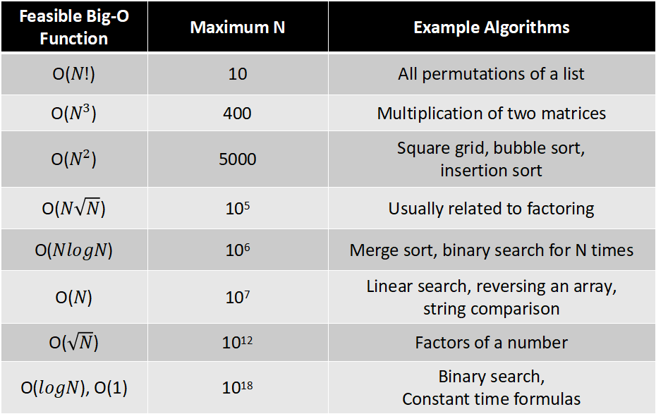
Time Complexity based on Constraints
Feasible Big-O Function | Maximum N | Example Algorithms
O($N!$) | 10 | All permutations of a list
O($N^{3}$) | 400 | Multiplication of two matrices
O($N^{2}$) | 5000 | Square grid, bubble sort, insertion sort
O($N\sqrt{N}$) | 10⁵ | Usually related to factoring
O($NlogN$) | 10⁶ | Merge sort, binary search for N times
O($N$) | 10⁷ | Linear search, reversing an array, string comparison
O($\sqrt{N}$) | 10¹² | Factors of a number
O($logN$), O(1) | 10¹⁸ | Binary search, Constant time formulas

Slide 14
Space Complexity
Space complexity is similar to time complexity, except it measures the amount of memory.
Any datatype that has constant memory takes O(1) space. Example: int, char, long long int, double, etc.

Slide 15
Space Complexity
Most problems have a memory limit of 256MB or ~2e8 bytes.
Datatype | No. of bytes
char | 1
int | 4
float | 4
long long int | 8
double | 8
long double | 16

Slide 16
Verdict of a solution
AC: Accepted
WA: Wrong Answer
TLE: Time Limit Exceeded
MLE: Memory Limit Exceeded
RE: Runtime Error
NZEC: Non Zero Exit Code
SIGSEGV: Usually due to out of bounds
SIGFPE: Usually division or modulo by 0
SIGABRT: Due to assert statements

Slide 17
Points to note:
Identify the variables that contribute to time complexity.
Just because constraints allow slower solutions, doesn’t mean there’s not a fast solution. For example, if N <= 1000, then both O(N²) and O(N) can pass.
Testcases matter, unless there’s a limit explicitly imposed in the constraints.
The constants and constant factors removed when calculating Big-O still matter.

Slide 18
Problems to test understanding
https://codeforces.com/contest/1647/problem/A
https://codeforces.com/problemset/problem/1538/C
https://www.codechef.com/MARCH221D/problems/DISCUS
https://www.codechef.com/MARCH221D/problems/WORDLE
https://www.codechef.com/MARCH221D/problems/CHFDBT
https://codeforces.com/contest/1651/problem/B
https://codeforces.com/contest/1651/problem/A
https://codeforces.com/problemset/problem/919/B
For more practice, try to figure out the time complexity for any random problem.

Slide 19
Further Reading:
https://towardsdatascience.com/essential-programming-time-complexity-a95bb2608cac
https://www.youtube.com/watch?v=9TlHvipP5yA https://www.youtube.com/watch?v=9SgLBjXqwd4 https://www.youtube.com/watch?v=I0DTkS1LJ2k
https://adrianmejia.com/most-popular-algorithms-time-complexity-every-programmer-should-know-free-online-tutorial-course/ (advanced)

